Slide 1
Building a Patient Experience Model
Improve patient experience and satisfaction
Data from CMS.gov
Leah Prince
Notes:
The scope of this project is in reference to building a predictive model that will allow hospitals to predict patient experience.

Slide 2


Targeting Patient Experience
The Benefits
Increase patient engagement
Better patient outcomes
Continuity of care
Increase employee moral
Improve hospital reputation
Reduce risks of malpractice
Increase hospital financial success
Patient Satisfaction
Low Cost
Better Care
Notes:
By understanding patients’ experiences, hospitals can build better relationships with their patients, as well as receive monetary rewards for top-box ratings.

Slide 3
Improve Patient Experience
Ways to Improve Patient Experience
1.
Communication
Communication Barriers
Race
Language
Gender
Age
Mental State
Illness
Courtesy and Respect
Listen to Concerns
Provide Explanations
Notes:
Being able to communicate effectively is the most important skill in building healthy relationships. Therefore, doctors and nurses must receive the highest rating possible on their communication skills with their patients.

Slide 4
HCAHPS Survey Analysis
What is HCAHPS?
First national, standardized, publicly-reported survey of patients' perspectives of hospital care
Captures the patients' experience of communication with doctors and nurses, responsiveness of hospital staff, communication about medicines, cleanliness and quietness of the hospital, discharge information, transition to post-hospital care and overall rating of the hospital
Administered between 2 and 42 days after discharge to a random sample of patients, by mail, telephone and interactive voice response, in a variety of languages
Classification of Ratings
Top Box Rating
1
2
3
4
5
1
2
3
4
5
Rating Scale
0
1
Notes:
The data used in this analysis is collected from a publicly available, standardized survey, provided by the Centers for Medicare & Medicaid. The survey is designed to produce data about patients’ perspectives of hospital care. Each question in the survey can be rated on a scale from 1 to 5. A top box rating is considered a 5. Top box ratings were classified into binary classifications, with a 1 for top ratings and all other ratings were classified as 0.

Slide 5

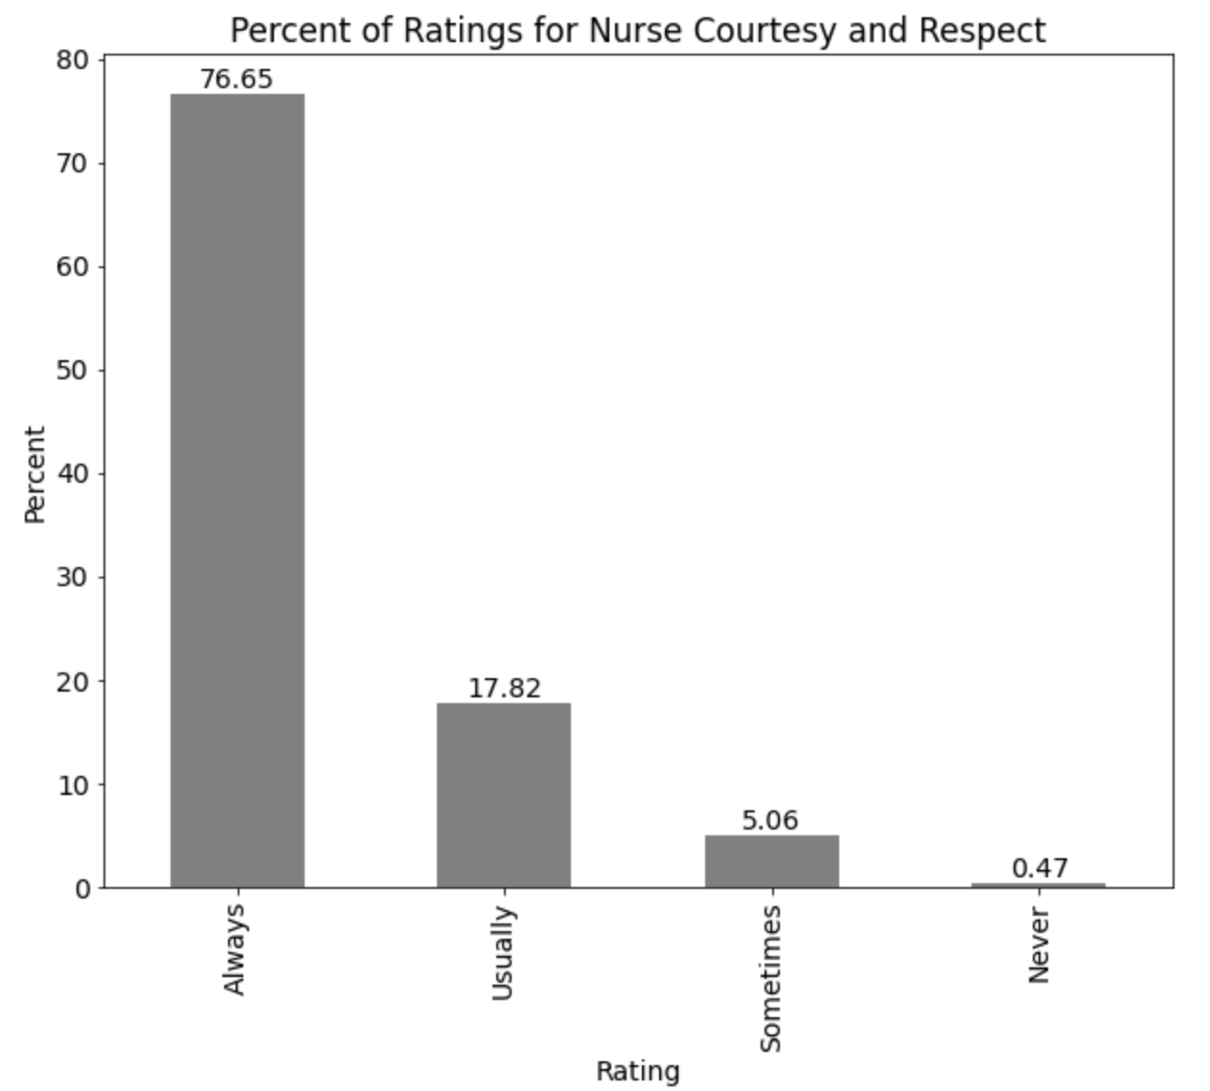
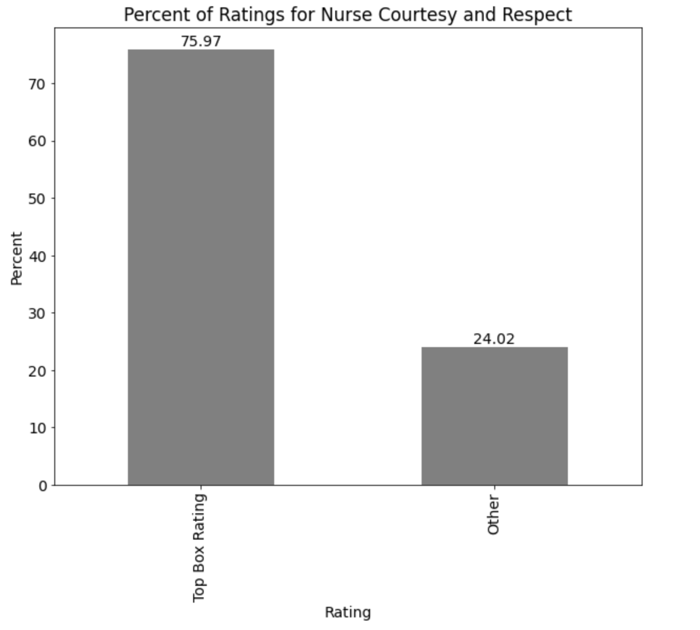

Deep Dive into Nurse Communication
Nurses are on the front lines of health care
A healthy nurse-patient relationship built on trust and respect goes a long way
It’s important to understand the uniqueness of this relationship and how it contributes to the overall patient experience
76% of patients said nurses were always courteous and respectful
24% of patients said nurses were not always courteous and respectful
Dealing with unbalanced data
Notes:
Nurses are on the forefront in establishing communication lines with patients. They are typically the first person you may interact with when visiting a hospital. Although, this dataset contains an overall rating of patient experience, the overall rating is calculated based on each individual component, being the questions. It is important to understand the uniqueness of each question and how it contributes to the overall experience. Therefore, "Nurses Courtesy and Respect" will be predicted based on a number of feature variables. For this particular question, most ratings were top box ratings. Based on these percentages, the data is unbalanced and methods such as logistic regression and decision trees tend to predict only the majority class and treat everything else as outliers. Therefore, a process was performed to balance the data.

Slide 6
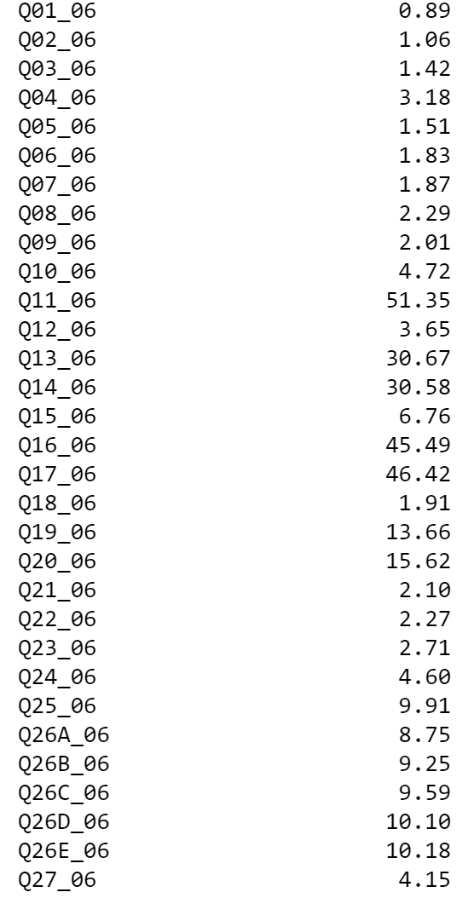
Missing Values in Survey
Handling Missing Values
Surveys contain missing responses if questions do not apply to the respondent
If missing values are removed, this may cause a significant amount of data loss
Missing values were replaced with a category to capture the missing data
c
c
c
Notes:
Missing data is known to occur in survey research for a variety of different reasons and there are different methods for resolving these issues. In this case, missing values were replaced with a category to capture the missing data. Once the missing values were replaced, each category was classified as 0 or 1 and the missing column that was created, could then be dropped. This method was applied to prevent a significant loss of data, by dropping the columns instead of the rows.

Slide 7
Model Building
Target | Predictors
Nurse Courtesy and Respect | Nurses Listen, Nurses Explain, Spring, Summer, Gender, Critical Patient, Admission Source
Model Type | Accuracy | ROC AUC | Misclassified
Logistic Regression w/ Train, Test, Split | 84.70 | 79.9 | False Positives: 4056 False Negatives: 4691
Logistic Regression w/ Kfolds = 10 |  | 87.36
Logistic Regression w/ Cross Validation = 10 |  | 87.03 | False Positives: 13410 False Negatives: 15254
Decision Tree – using undersampling | 82.57 | 87.1 | False Positives: 1976 False Negatives: 2814
Random Forest – using undersampling ** All variables were thrown into the model, so that a feature selection could be ran | 82.62 | 88.8 | False Positives: 1953 False Negatives: 2825
Random Forest w/ Feature Variables – using undersampling | 82.62 | 88.2 | False Positives: 1958 False Negatives: 2818
Decision Tree w/ Feature Variables – using undersampling | 82.62 | 88.2 | False Positives: 1958 False Negatives: 2818
Notes:
Three different model types were used to determine the best model for predicting hospital patient experience. Different methods were applied to these models, such as splitting the data into a training and testing set, using different subsets of data, to reduce biasness, as well as overfitting in the data. Many different features were used, such as nurses listen, nurses explain, seasons, gender, critical hospital patient and admission sources. However, the final model that was chosen, with the best accuracy was the Decision Tree using the best features of importance. These features included, nurses listen, nurses explain and hospital cleanliness.

Slide 8
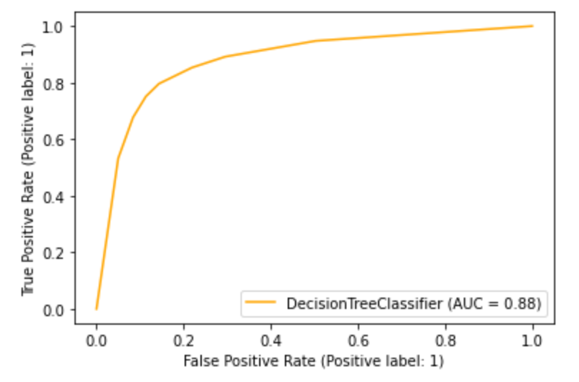
Final Model – Decision Tree (using features of importance)
Overview of Model Accuracy
Model Type | Accuracy | ROC AUC | False Positives | Sensitivity | Specificity
How often is the classification correct? | 88.62 | 88.2 |  |  |  | (True Positives + True Negatives)/Total True Positives & Predicted probabilities
How often is the model incorrect? |  |  |  |  |  | (False Positives + False Negatives)/Total
When the actual is yes, how often does it predict yes? |  |  |  | 79.6 |  | True Positives/Actual Yes
When the actual is no, how often does it predict yes? |  |  | 14.3 |  |  | False Positives/Actual No
When the actual is no, how often does it predict no? |  |  |  |  | 85.6 | True Negatives/Actual No
n = 27,493 | Predicted: NO | Predicted: YES | Total
Actual: NO | TN = 11,699 | FP = 1958 | 13,657
Actual: YES | FN = 2,818 | TP = 11,018 | 13,836
Total | 14,517 | 12,976
Notes:
The following charts break down the classifications for the two predicted classes, which are yes and no. Yes, means patients gave a top box rating. No, means patients did not give a top box rating. There was a total of 27,493 predictions made. Out of that total, yes was predicted a total of 12,976 times and no was predicted a total of 14,517 times. Out of all the actual top box ratings, the model predicted yes, with a score of 79.6. For the ratings that were not top box, and were low ratings, the model predicted these as top box ratings, with a score of 14.3. That score is not too concerning and is low compared to the fair number of accurate predictions that were made. Then when you compare that to, what was an actual low rating and the model predicted it as a low rating as well, that score was 85.6, so that is pretty good. That leaves a total accuracy of 88.62 and a ROC AUC of 88.2. Overall, this is a pretty good performing model.

Slide 9
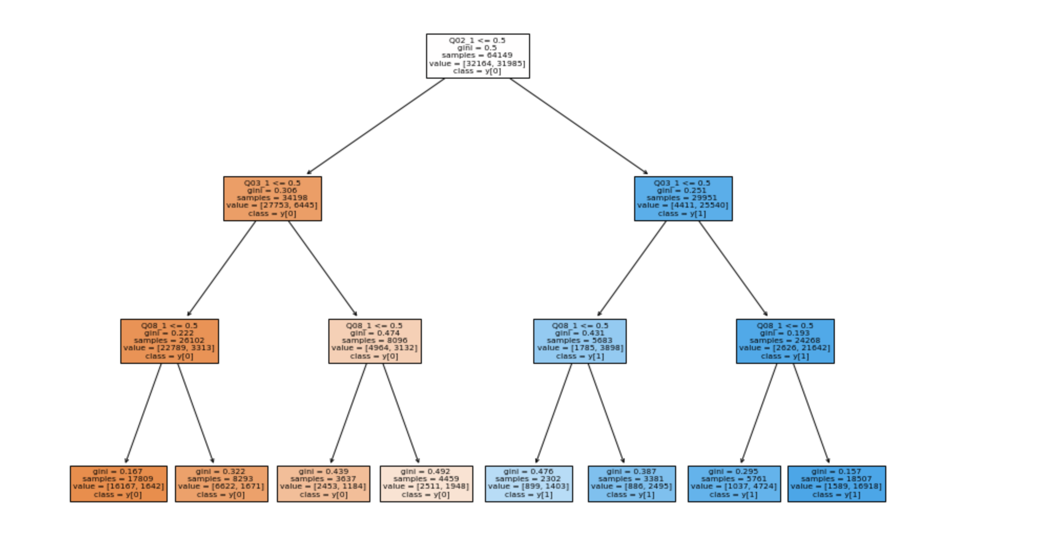
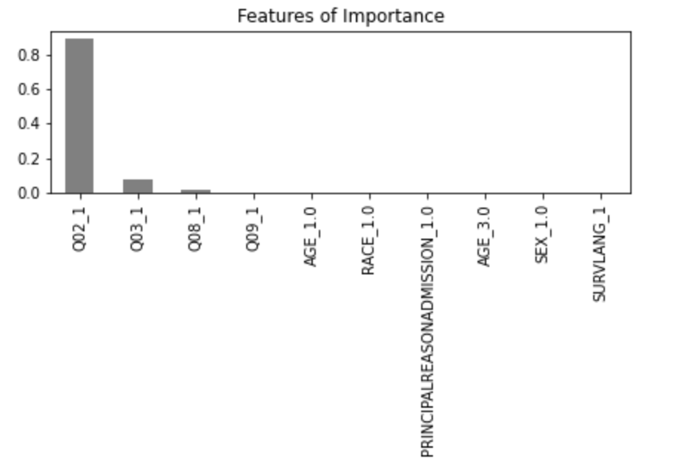
Final Model – Decision Tree (using features of importance)
Results of Model
Notes:
The model determined that nurses listen is the best feature variable to start from in predicting nurses’ courtesy and respect. This makes a lot of since because typically a person who has courtesy and respect, may also have characteristics of good listening skills and explaining things well. There was a total of 64,149 samples used and out of that total, there was 31,985 predictions of a top box rating and 32,164 predictions of a lower rating. As we follow the path of the model purity, nurses explain was the next feature of importance. Out of 29,951 samples, there were 25,540 positive predictions, and only 4,411 negative predictions. Finally, hospital cleanliness was the last feature of importance, with a total of 16,918 positive predictions and only 1,589 negative predictions.

Slide 10
Conclusion
Nurses Courtesy & Respect
Nurses Listen
Nurses Explain
Hospital Cleanliness
Notes:
In order for nurses to receive a top box rating, the model predicts that nurses must also receive top box ratings in listening skills, explaining things well and ensuring a clean environment for their patients. Understanding these features of importance and how it influences the rating for nurse’s courtesy and respect can be beneficial to hospitals when it comes to training nurses on building patient-centric relationships. It will also help hospitals understand the characteristics that are important to patients when determining how satisfied patients are with their experience. In addition, by understanding the uniqueness of each question and taking action to make improvements when needed, will lead to a much higher overall rating for the hospital.

Slide 11
Recommendations
Add in new features to the dataset
Complaints from patients
Length of waiting times
Patient diagnoses
Hospital names
Readmissions
1
2
Check data quality
Are there any issues with the dataset?
Noticeable issues were discrepancies between the data dictionary and the actual dataset.
3
Cluster the data
Detect if there are similarities in different features, using the new inputs.
Notes:
As previously noted, the ROC AUC achieved an 88.2. However, we can increase this score even higher by making some changes to the data. My suggestions would be to add in new features to the dataset, such as complaints from patients, length of waiting times, patient diagnoses or hospital names, to see if that helps with the model performance. Although, there were many input variables to use, only a select few were useful to the model, so it may be beneficial to double check the accuracy of the data to determine if there are issues with the dataset or the features being used.

Slide 12
Q&A
?

